Slide 1

DCS5211C Final Report
WANG XINRUI A0186103M
This report is to apply methods and tools acquired in this course to analyze the assigned real dataset. There are two main parts, which are time series analysis and risk measurement.

Slide 2
CONTENTS
工作完成情况
明年工作计划
请替换文字内容，修改文字内容，也可以直接复制你的内容到此
请替换文字内容，修改文字内容，也可以直接复制你的内容到此
STEP 1
STEP 3
STEP 2
STEP 4
年度工作概述
成功项目展示
请替换文字内容，修改文字内容，也可以直接复制你的内容到此
请替换文字内容，修改文字内容，也可以直接复制你的内容到此

Slide 3
PART 1
Time Series Analysis
Part I concentrates on investigating the pattern with time and applies various models to find the best one. Then do out-of-sample forecasts for the series using the final model.

Slide 4
Analytics Flow
Testing
标题
标题
标题
1
2
3
4
标题文本
标题文本
标题文本
标题文本
点击此处更换文本，点击此处更换文本
点击此处更换文本，点击此处更换文本
点击此处更换文本，点击此处更换文本
点击此处更换文本，点击此处更换文本

Slide 5
Series Visualization
Scatter plot: identify trend and seasonality in the series.
Graph 1-1: the data shows a linear/exponential increasing trend.
Also, there may be seasonality.
Durbin-Watson test will tell us which model should we use.
Notes:
Session 3 Graphs and correlation analysis - plot to get a feel for relationship & spot problems
- correlations measure strength of relationship

Slide 6
Durbin-Watson Test
Notes:
In the result, click residual the picture will be shown
Residuals should be simple randomness remaining after deterministic part of variation in the dependent variable has been modelled.
The plot shows that there is a pattern in the residuals: the volatility is increasing over time.
Multi-collinearity reflected in big uncertainty on coefficients, i.e. large standard errors, and thus small t-stats
Heteroscedasticity: Log linear Model

Slide 7
Durbin-Watson Test
Durbin-Watson stat = (), which is less than our critical value ().
There is serial correlation in the data.
It is necessary to use AR model.
Notes:
Import data -> quick -> estimation equation -> y c xs -> ok -> t distribution -> less than critical value -> serial correlation
DW statistic evaluates autocorrelation for residuals
DW statistic evaluates autocorrelation for residuals placed in same order as the observations. Session 3 page 21

Slide 8
Moving Average
Simple moving average of recent points
mt = 1/3 Yt + 1/3 Yt-1 + 1/3 Yt-2 Weighted moving average
mt = 1/2 Yt + 1/3 Yt-1 + 1/6 Yt-2 Exponentially weighted moving average
mt = 1/2 Yt + 1/4 Yt-1 + 1/8 Yt-2 + . . . .
MAPE =
Mean Absolute Percentage Error
MSD =
Mean Absolute Deviation
MSD =
Mean Squared Deviation

Slide 9
Moving Average
Simple moving average of recent points
mt = 1/3 Yt + 1/3 Yt-1 + 1/3 Yt-2 Weighted moving average
mt = 1/2 Yt + 1/3 Yt-1 + 1/6 Yt-2 Exponentially weighted moving average
mt = 1/2 Yt + 1/4 Yt-1 + 1/8 Yt-2 + . . . .
MAPE =
Mean Absolute Percentage Error
MSD =
Mean Absolute Deviation
MSD =
Mean Squared Deviation
Notes:
Session 2 page5

Slide 10
Holt - Exponential Smoothing
MAPE =
Mean Absolute Percentage Error
MSD =
Mean Absolute Deviation
Simple exponential smoothing is not an appropriate forecasting technique for series with trend.
MSD =
Mean Squared Deviation
Notes:
Session 2 page20
Holt’s method takes into account both level and growth
see best workshop2
Page 11 Simple Exponential Smoothing
Alpha is usually 0.1 to 0.3, to be optimised as in regression
Low alpha
- Low weight to latest observation
- Much smoothing
- Slow response to structural change
- Best for rapidly fluctuating, noisy series

Slide 11
Holt-Winters Exponential Smoothing
MAPE =
Mean Absolute Percentage Error
MSD =
Mean Absolute Deviation
MSD =
Mean Squared Deviation
Notes:
Session 2 page24
Holt-Winters method accounts for level, growth and multiplicative seasonality
All between 0 to 1
If smoothly changing seasonality, could use high sigma
Page 29: Exponential Smoothing – Advantages and Disadvantages

Slide 12
单击这里输入大标题
标题文本预设
此部分内容作为文字排版占位显示（建议使用主题字体）
标题文本预设
标题文本预设
此部分内容作为文字排版占位显示（建议使用主题字体）
此部分内容作为文字排版占位显示（建议使用主题字体）
标题文本预设
此部分内容作为文字排版占位显示（建议使用主题字体）
标题文本预设
此部分内容作为文字排版占位显示（建议使用主题字体）
Notes:
VAR models are basically a combination of multiple equations models and multi-variate time series techniques.
Box-Jenkins Methodology - requires series to be stationary so use Dickey-Fuller tests and difference if necessary
– Model Identification - ACF & PACF
– Model Estimation - estimate several candidates

Slide 13
Stationarity Test – ADF test
parameters
parameters
parameters
parameters
Notes:
Two graphs: series plot and test result
Double check the series -> View -> unit root test
Stochastic trend can be identified by testing a1 =1: Dickey-Fuller Tests
If fail to reject, imply random walk type behaviors, i.e. non-stationarity
How many lags should be included.
Level/1st difference intercept/trend/none

Slide 14
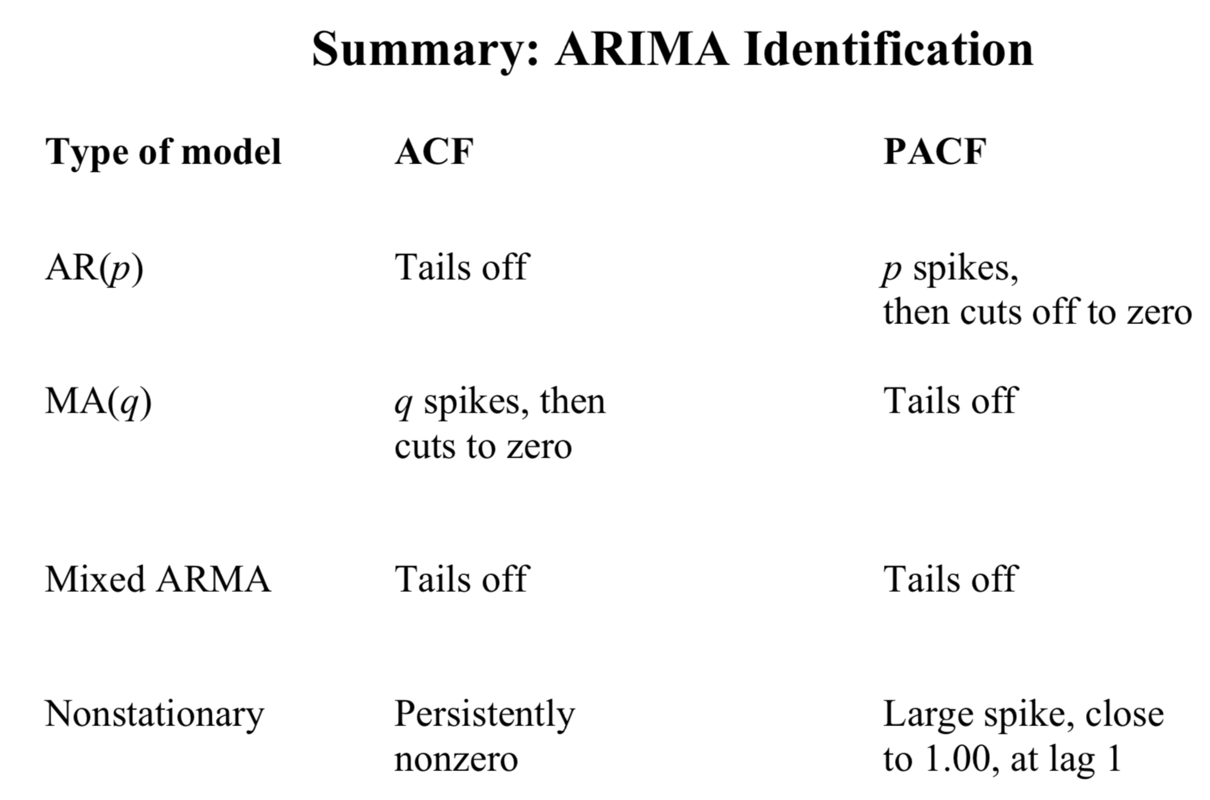
Model Identification - Correlogram
reason
Notes:
Session 4, page 24
autocorrelations are significant for first few orders and die away exponentially
Double check the series -> View -> correlogram: lag to include 24
Correlogram displays autocorrelation function for different lags. Using differenced variables (changes) eliminates the trends and thus avoids spurious regression.

Slide 15
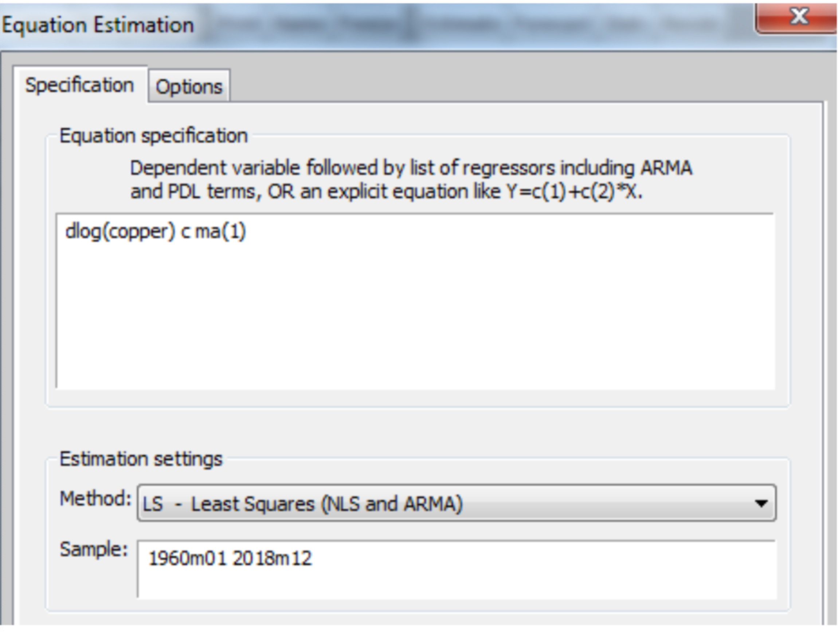
Model Evaluation
ARMA()
SSR =
AIC =
From the ACF we can find that,
ARMA()
SSR =
AIC =
ARMA()
SSR =
AIC =
Notes:
Steps: quick -> equation estimation -> options: GLS
Session 4 page 34: how to represent equation
AUTOCORRELATION: • We can investigate ACF of the residuals
• We cannot use DW when lag Yt is an explanatory variable
Ljung-Box Q-statistic has a chi-squared distribution with d.f. = (m-p-q) correlogram of residuals

Slide 16
Forecast Evaluation
Theil Inequality Coefficient: 3.4% indicates a very good fit.
Bias Proportion: 5%
the forecast for the mean are very close to the actual values.
Variance Proportion: 0.3%
the variance of the forecasts is almost perfect! This is due to modelling seasonal behavior.
Covariance Proportion: 94.6%
a big proportion of forecasting errors are unsystematic.
Notes:
• Theil Inequality Coefficient: lies between zero and one (ZERO indicates a perfect fit).
• Bias Proportion tells us how far the mean of the forecast is from the mean of the actual series.
• Variance Proportion: tells us how far the variation of the forecast is from the variance of the actual series

Slide 17
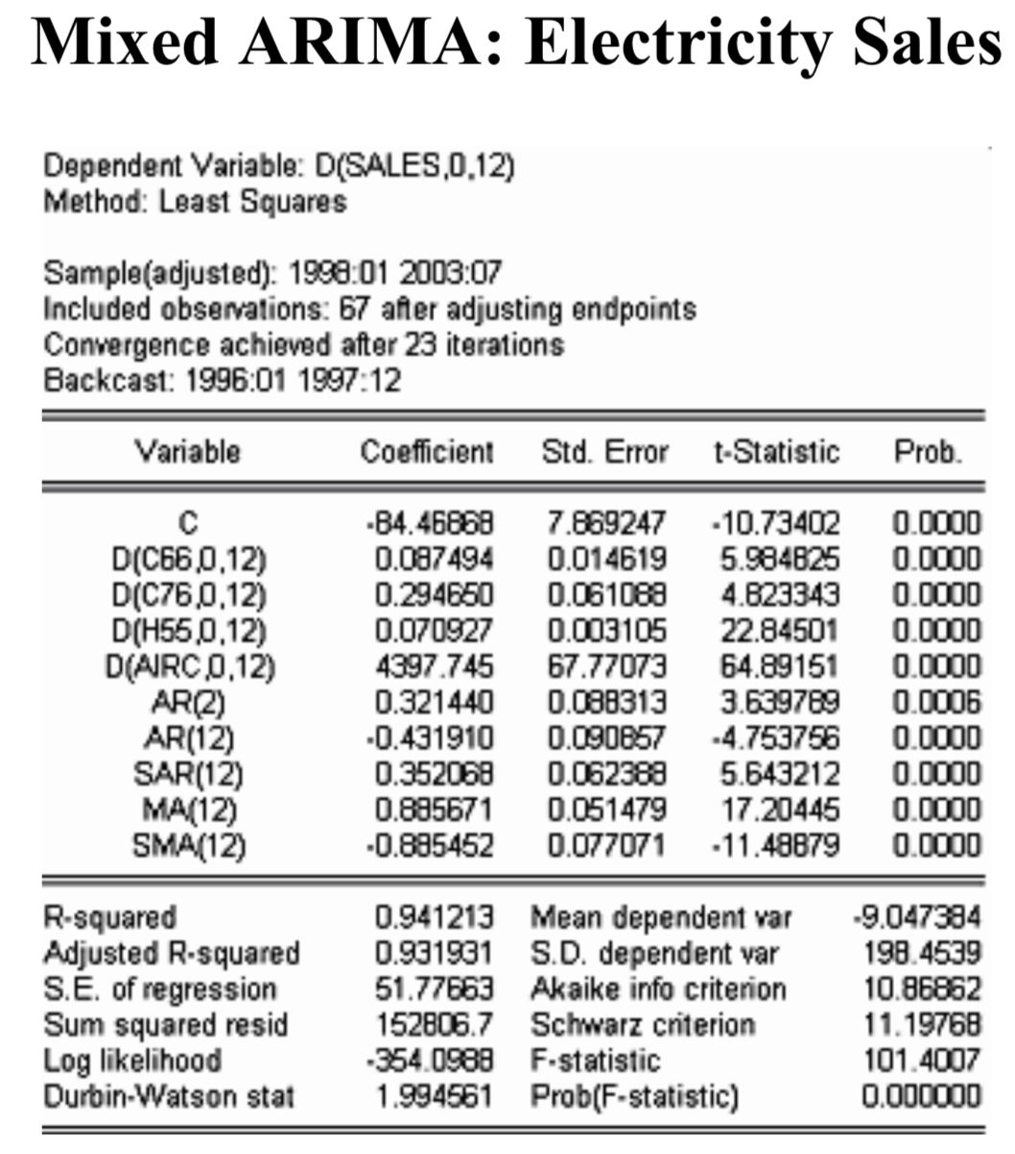
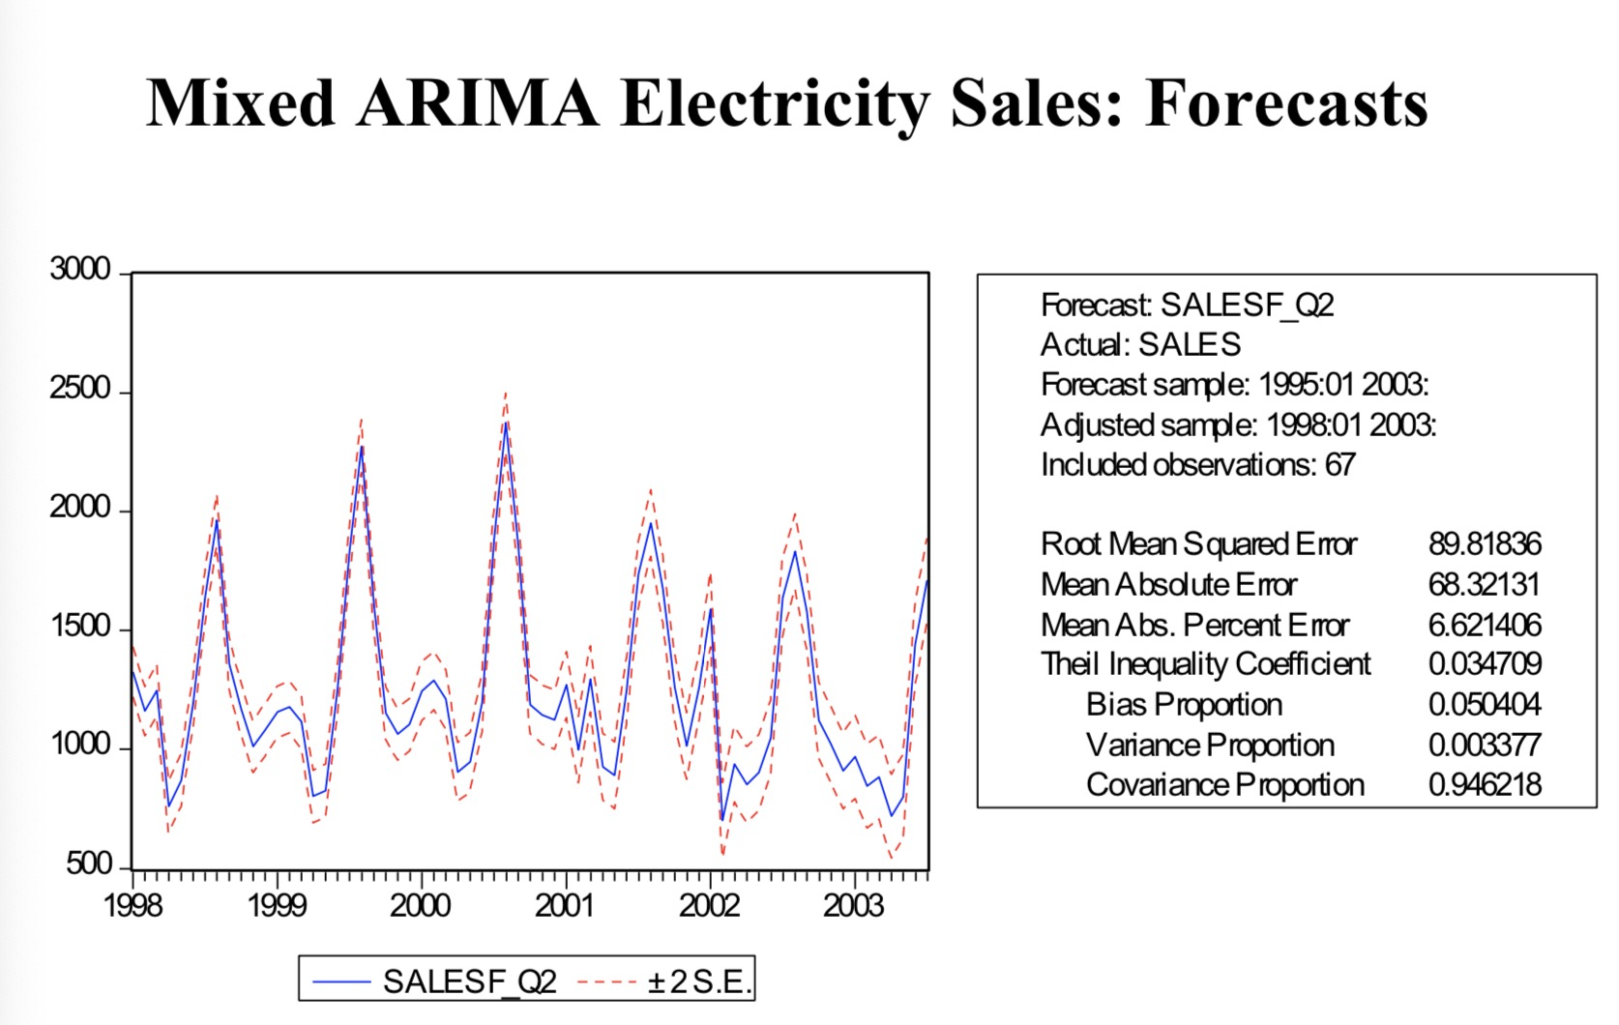
Mixed ARIMA Regression

Slide 18
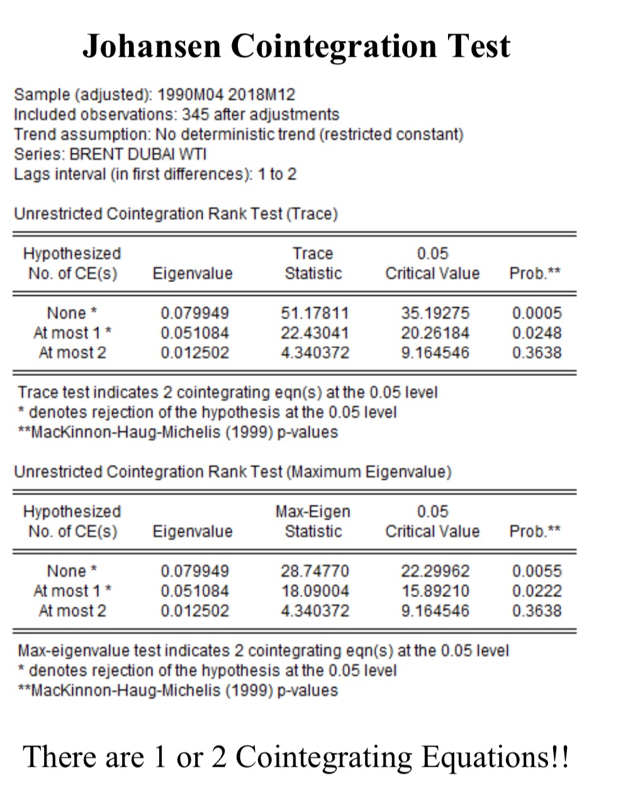
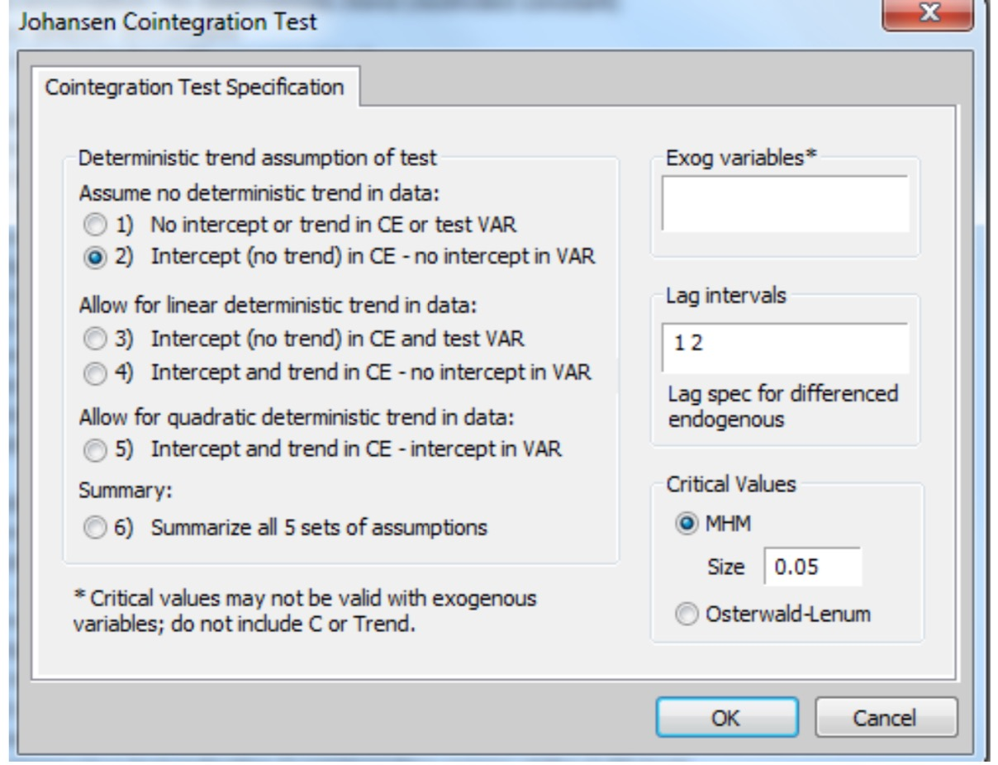
Johansen Cointegration Test
The theory of co-integration allows us to integrate short-run dynamics with long-run equilibrium.
The trace rank test suggest that there is only 1 co-integration equation at 5% level as the hypothesis that there is at most 1 cointegration equations cannot be rejected.
Notes:
Quick -> group statistics -> john cointegration test

Slide 19
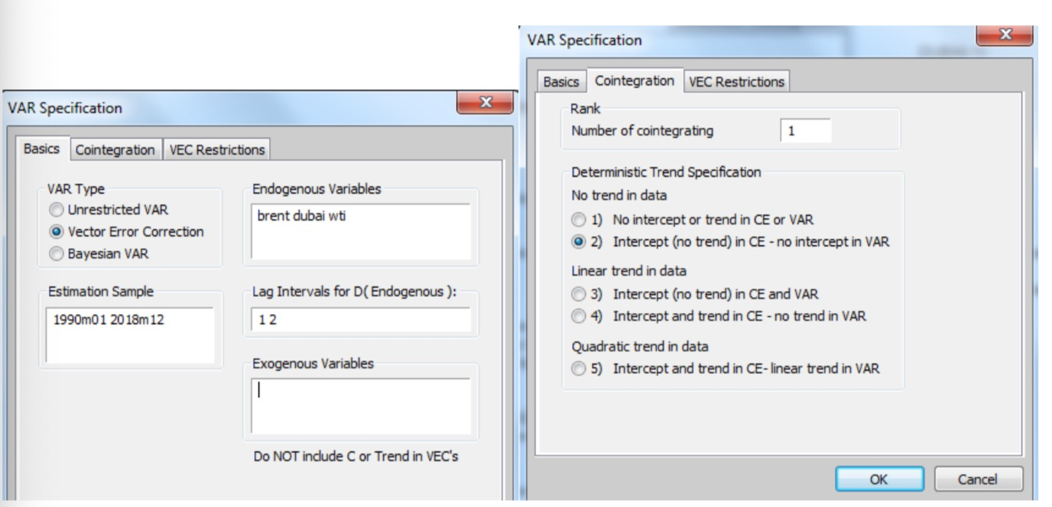
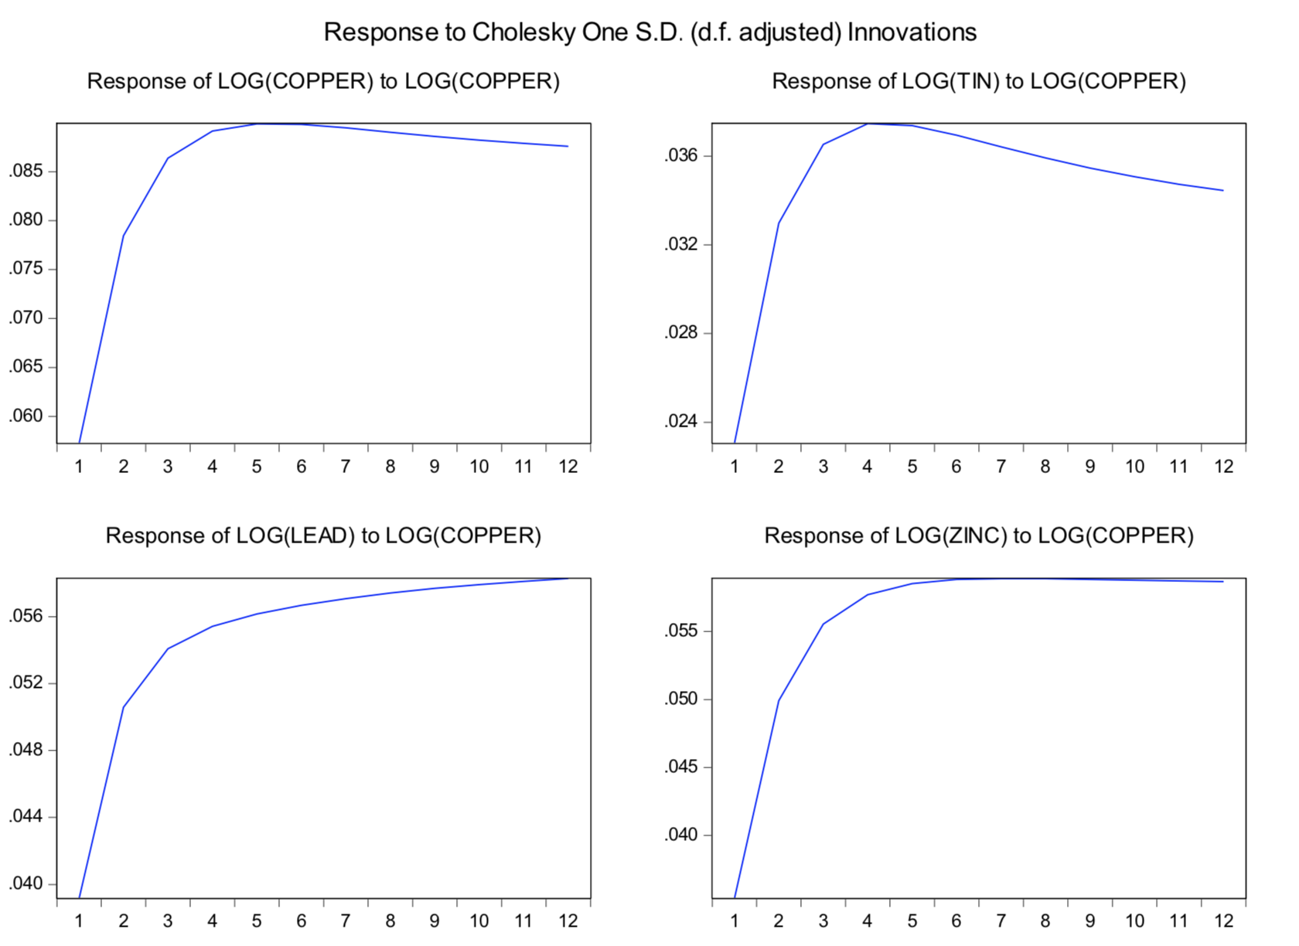
Cointegration
The theory of co-integration allows us to integrate short-run dynamics with long-run equilibrium.
Notes:
The essential insight here is that these parameters must be such that they purge or remove the stochastic trend from the linear combination.
Quick -> estimate var -> vector error correction view -> impulse response adjust impulses and responses

Slide 20
Out-of-Sample Forecasts
60%
55%
此部分内容作为文字排版占位显示 （建议使用主题字体）
此部分内容作为文字排版占位显示 （建议使用主题字体）
65%
70%
此部分内容作为文字排版占位显示 （建议使用主题字体）
此部分内容作为文字排版占位显示 （建议使用主题字体）

Slide 21
PART 2
Risk Analysis
Part II is an important part in real businesses, in which we will analyze the risk using various tools including VaR, CVaR, worst-case, etc. Through tuning parameters, we aim to find the underlying pattern.

Slide 22
Methodology Flow
Worst-case
expected loss conditioned in being in excess of VaR
Conditional Value at Risk
expected loss conditioned in being in excess of VaR
Value at Risk
the worst loss over horizon T with a level of confidence
Historical Data
hypothetical distribution
Monte Carlo Simulation
randomly generated movements
Worst-case
CVaR
VaR
Calculation
Measures of Extreme Risk
Notes:
A risk measure is coherent if it satisfies:
Convexity
Monotonicity
Translation equivariance
Positive Homogeneity
CVaR is a coherent measure of risk
Page 13 and 14 在讲什么？？？

Slide 23
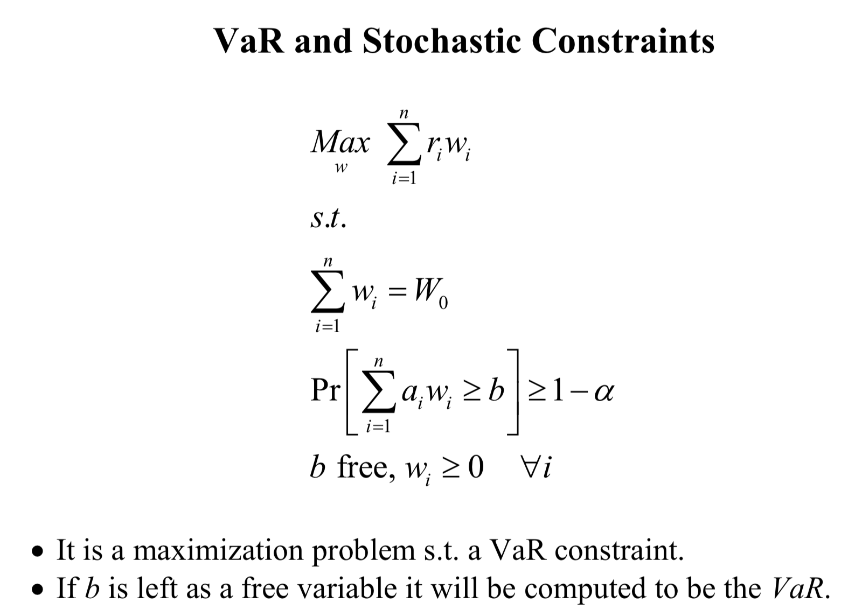
Expected Profit Maximization
The theory of co-integration allows us to integrate short-run dynamics with long-run equilibrium.

Slide 24
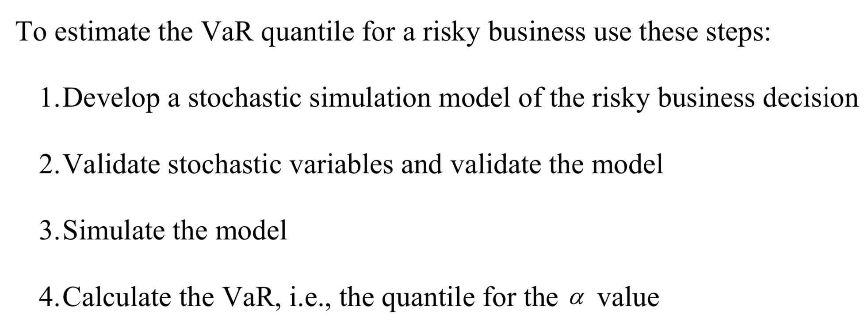
VaR Estimation using Simulation

Slide 25
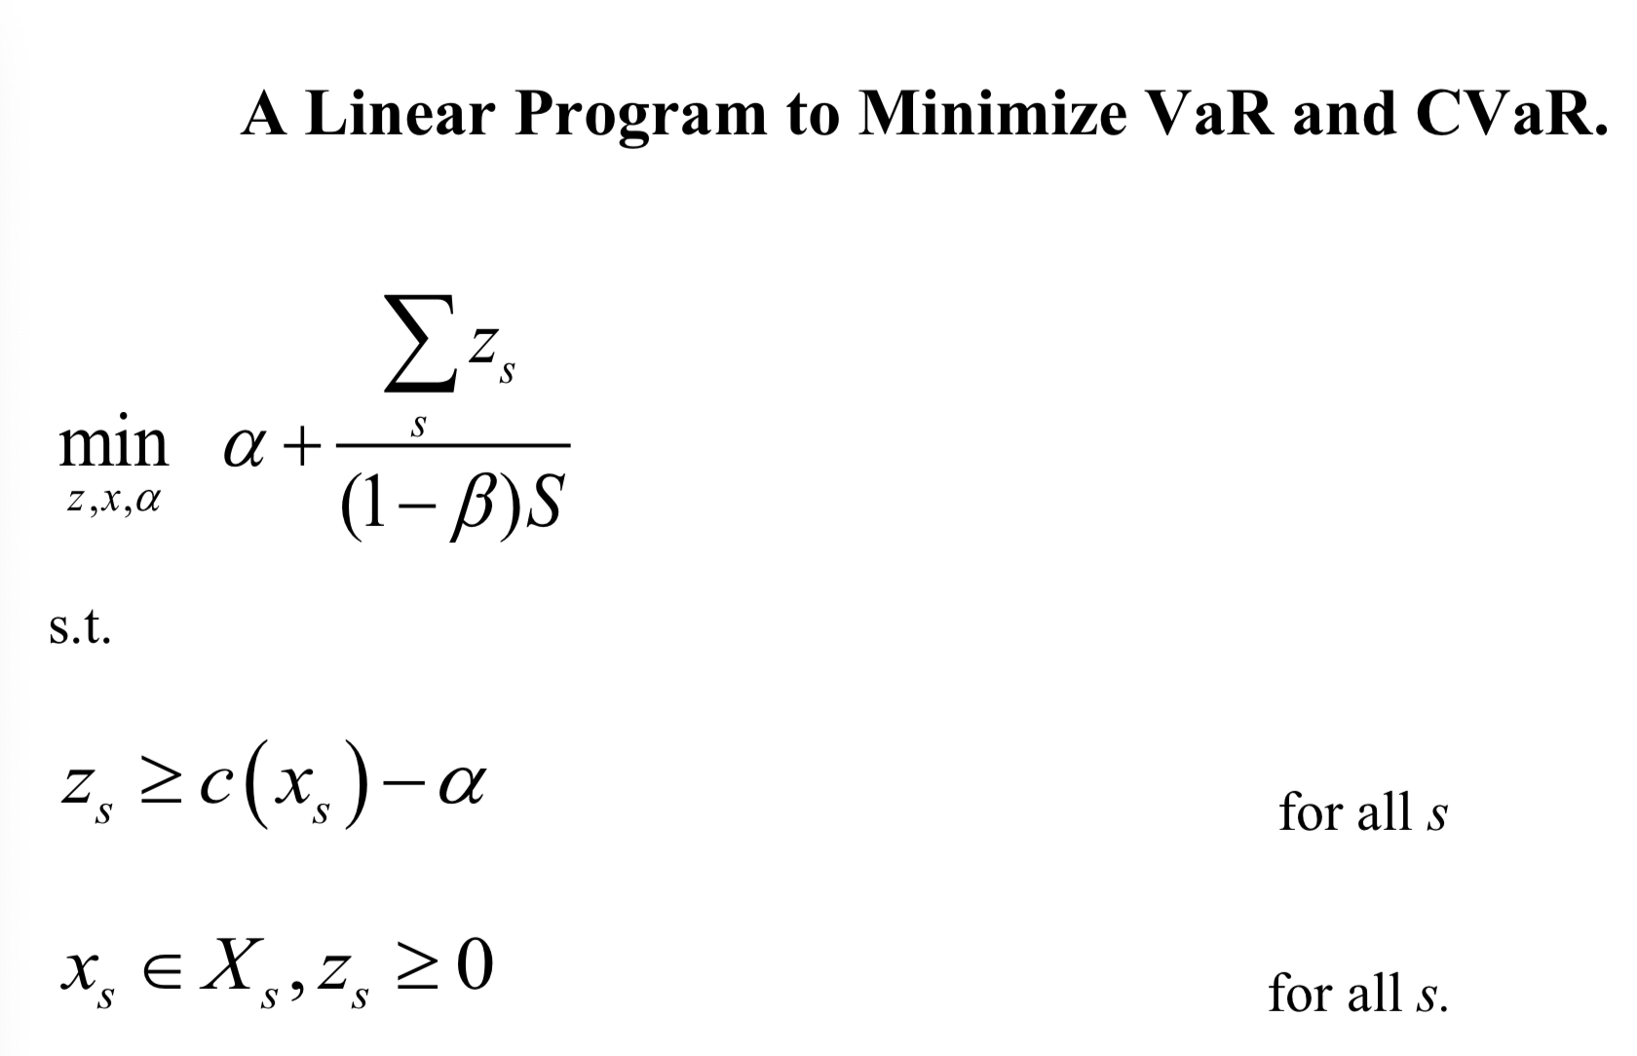
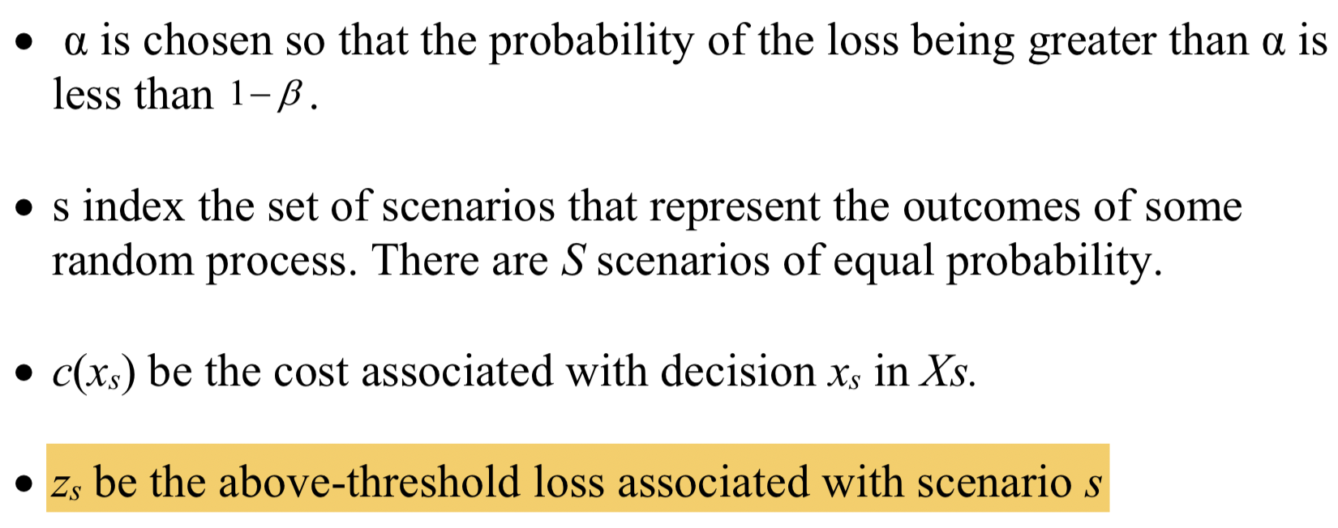
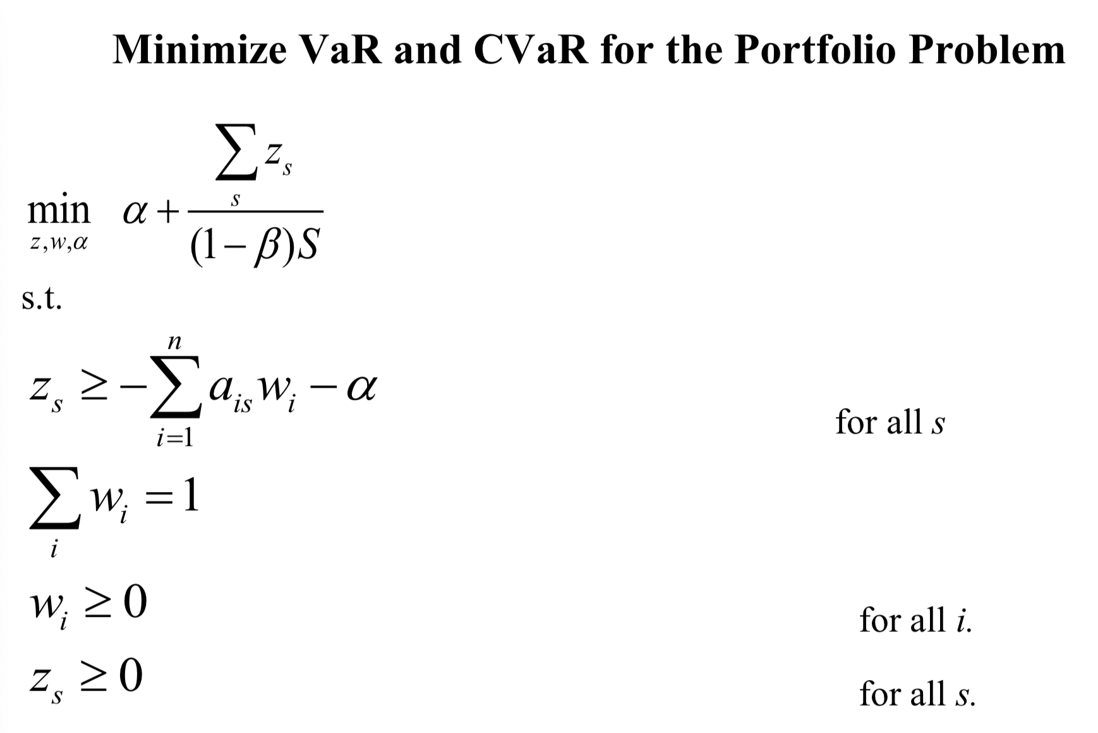
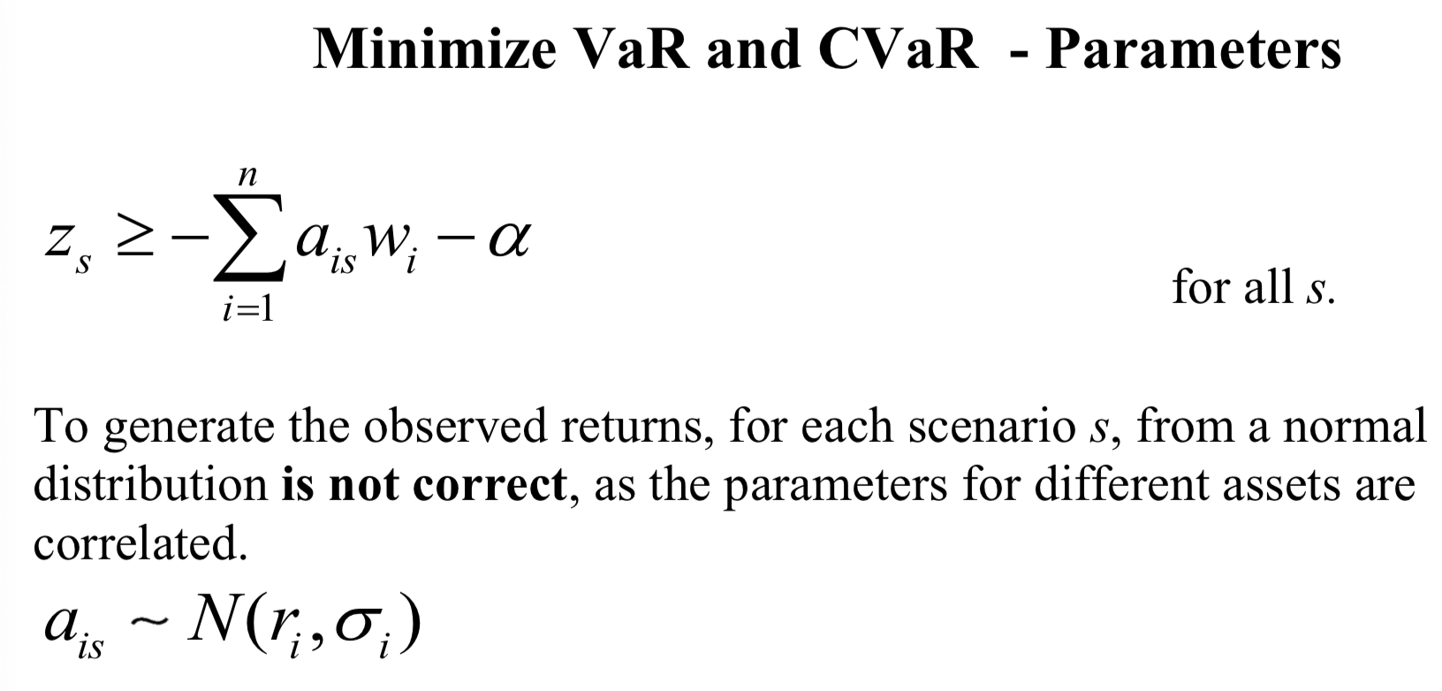
VaR / CVaR Minimization
Notes:
Session 9 page 26-29

Slide 26
This is a 分界线 ！！！ Session9 to session 10

Slide 27
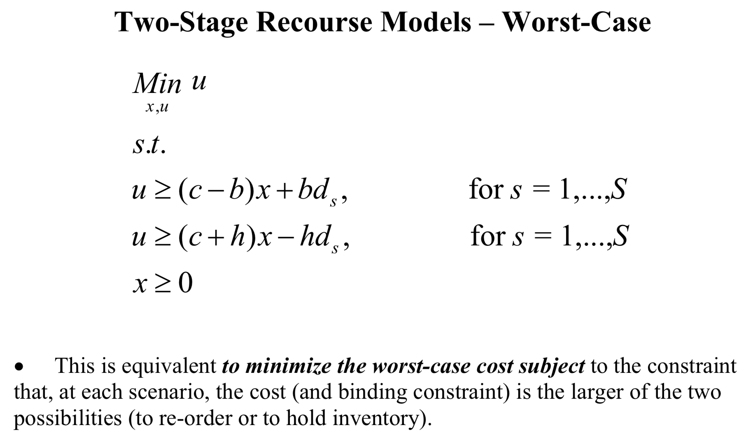
Worst – Case Analysis
Notes:
Worst-case analysis (min-max) provides robust optimal strategies that yield guaranteed performance.
The worst-case approach minimizes the objective function with respect to the worst possible outcome of the uncertain variables.
Session 10 page 34 example
There is a trade-off between risk and expected cost. The firm now has a higher expected cost. There is no risk, as the firm knows, with certainty, the cost of ordering and storing x units of the product.

Slide 28
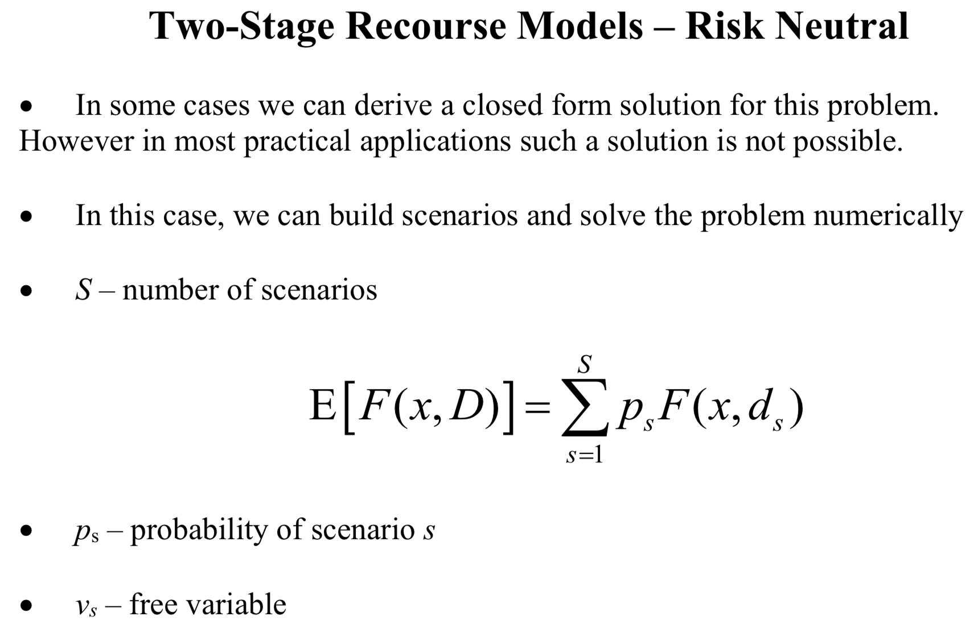
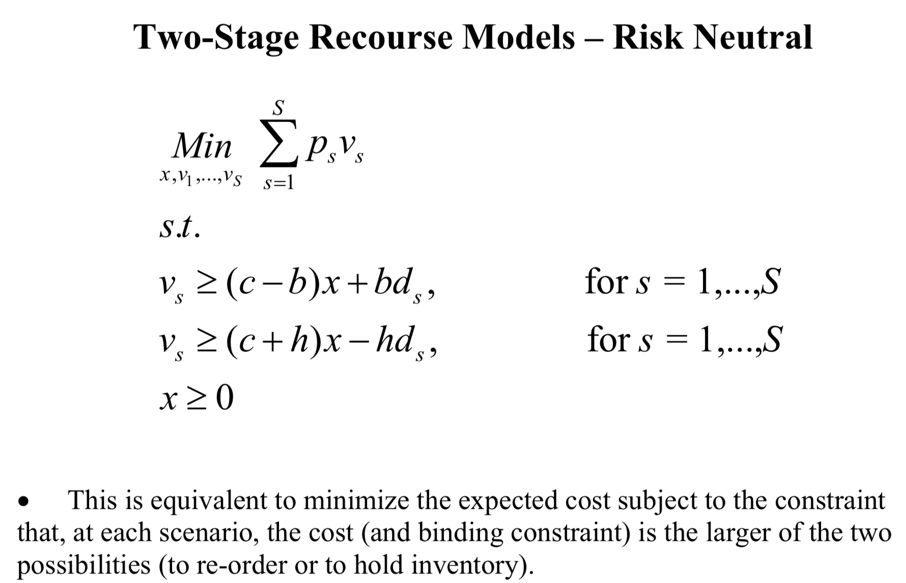
Risk-neutral Optimization
Notes:
Min E[F(x,D)]
session 10 page 32 example
In stage 1 we decide the order
In stage 2 we decide the recourse actions, level of storage or re- ordering quantities in order to cope with actual demand.

Slide 29
Comparison Risk Measures
添加
文本
在此添加标题描述，字数不用太多，简明扼要的归纳描述要点关键词；在此添加标题描述，字数不用太多，
Risk
Measure
添加
文本
在此添加标题描述，字数不用太多，简明扼要的归纳描述要点关键词；在此添加标题描述，字数不用太多，
添加
文本
在此添加标题描述，字数不用太多，简明扼要的归纳描述要点关键词；在此添加标题描述，字数不用太多，
When the Beta is zero, the Expected Profit and CVaR are the same. Similarly, when beta is 0.99999, the expected profit and CVaR are also the same (e.g. it could be that it is the worst case scenario (1 scenario)). The higher the CVaR, the higher the expected profit. For the worst-case profit ($0.00), and CVaR is also 0.

Slide 30
单击这里输入大标题
标题文本预设
04
此部分内容作为文字排版占位显示 （建议使用主题字体）
标题文本预设
03
此部分内容作为文字排版占位显示 （建议使用主题字体）
01
标题文本预设
此部分内容作为文字排版占位显示 （建议使用主题字体）
02
标题文本预设
此部分内容作为文字排版占位显示 （建议使用主题字体）

Slide 31
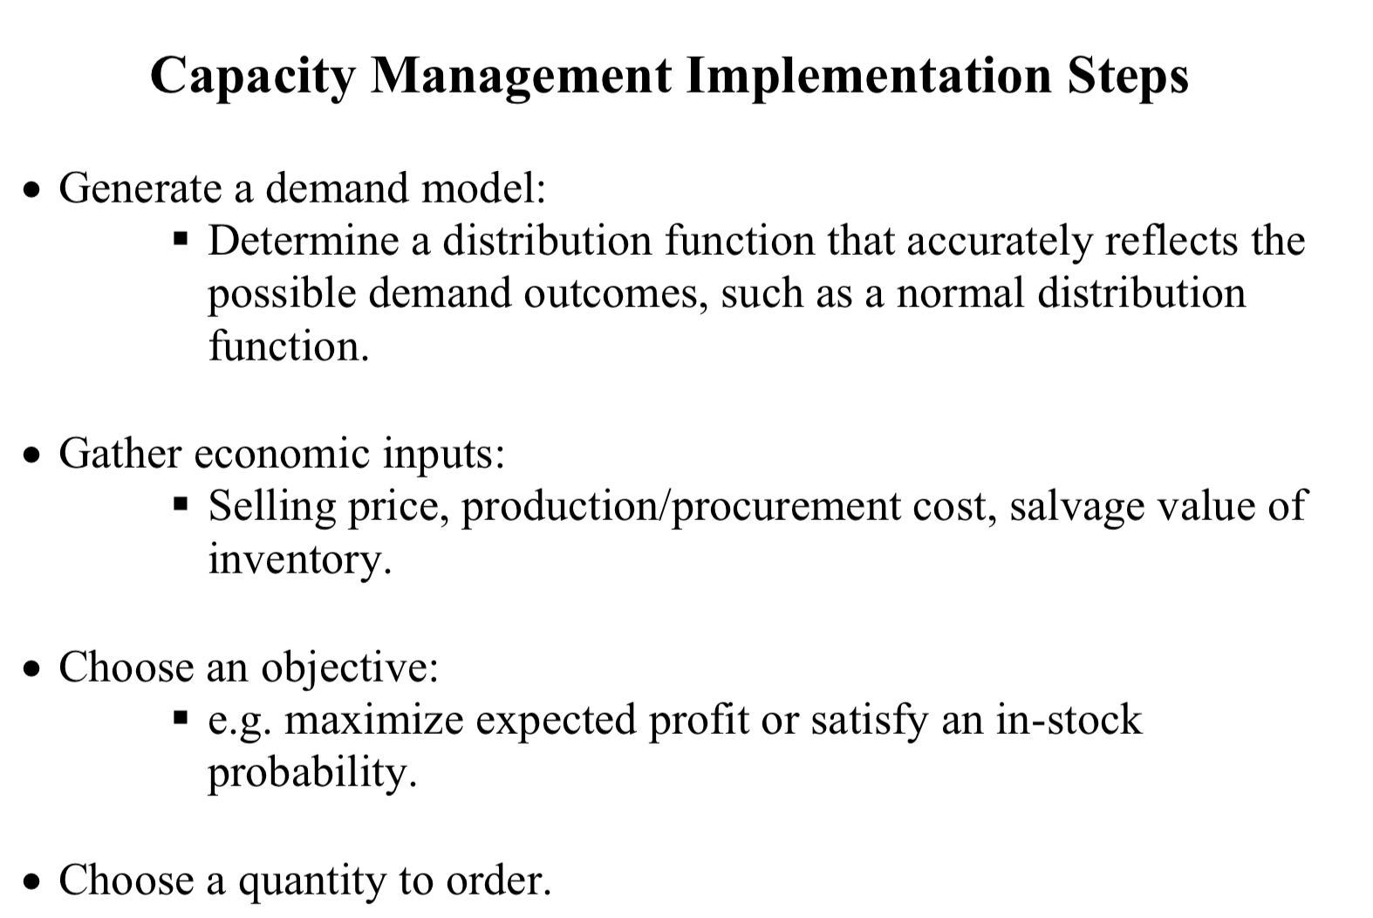

Slide 32
Thanks for Watching!
WANG XINRUI A0186103M

